Slide 1
CSS 080: Network Operating System
Mr. Siddy I. Siddy

Slide 2

File System Basics

Slide 3
File System Basics in Linux
The most commonly used file system in Linux distributions is the Extended File System (ext) family, with ext4
In Linux the file system starts at the root directory, represented by a forward slash (/), and all other directories and files are located below the root directory.

Slide 4
Here are some basic terms related to the Linux file system:
Directory:
A directory is a container for files and other directories. Directories are also called folders.
File:
A file is a collection of data that is stored on a computer. Files can be text files, image files, audio files, or any other type of data.
Path:
A path is the location of a file or directory in the file system. Paths can be either absolute or relative. An absolute path starts from the root directory, while a relative path starts from the current directory.
Permissions:
Permissions determine who can read, write, or execute a file or directory. There are three types of permissions: read, write, and execute. Permissions are assigned to three groups of users: the owner of the file, members of the owner's group, and everyone else.

Slide 5
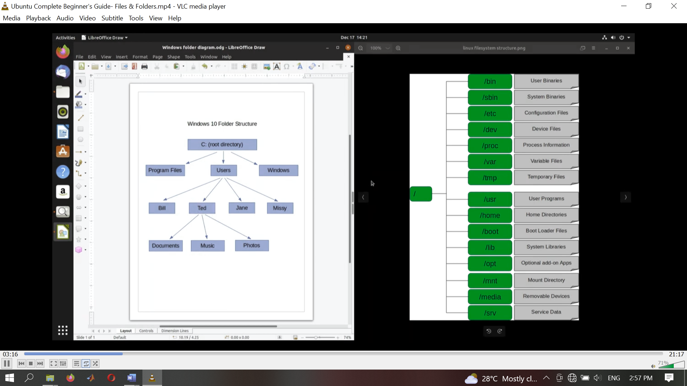
File system in Linux

Slide 6
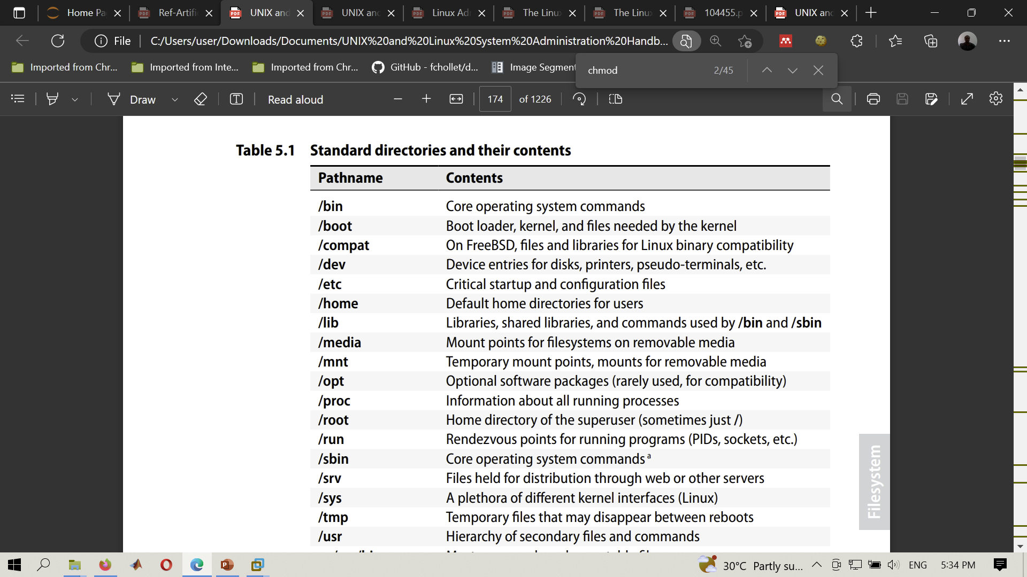
Standard directories and their contents

Slide 7
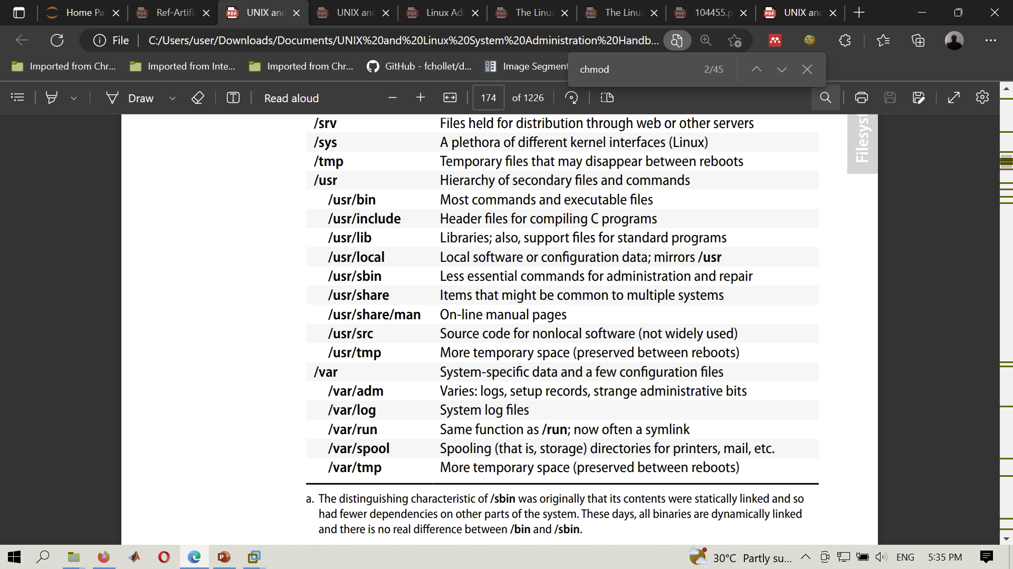
Standard directories and their contents

Slide 8
Advanced File System Concepts

Slide 9
Advanced File System Concepts
List the detail of the directory content >>ls -l
List hidden files >> ls -la
Print working directory >> pwd
Change the directory >> cd ..
Create empty file >> touch nameof-file

Slide 10
Advanced File System Concepts
Read and concatenate the file >> cat filename then control D to save the file
Create a folder >> mkdir foldername1 foldername2
Copying file to folder>> cp file1 file2
Move a folder >> mv file1 path/folder-name
Remove the empty directory/files>> rmdir file1.txt
Remove file >> rm file1.txt
Delete everything in a folder >> purge folder-name

Slide 11
Advanced File System Concepts
Create a file with data >> cat > filename
Editing the existing file >> cat/nano/gedit/vi >> filename then use control Z to exit also use wq to save and quit
Create new file from previous files >> cat file1 file2>new_file

Slide 12
Advanced File System Concepts
If you need to search the patterns on the files >>grep _pattern-to-search_ file.txt
Find the difference between two files>> diff file1.txt file2.txt
To review all commands history>>history
Display the host ip address>> hostname -i
Change the group/user permissions to access file>> chmod u=r file1.txt
meaning user will only read the file can’t write

Slide 13
Advanced File System Concepts
Displaying the line numbers>> nl
To get sum of words, lines etc on the file>>wc file1.txt
Remove the duplicates on the file>> uniq file1.txt

Slide 14
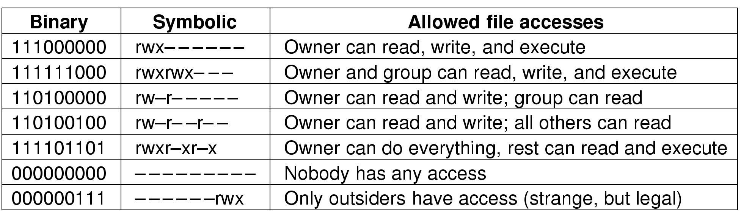
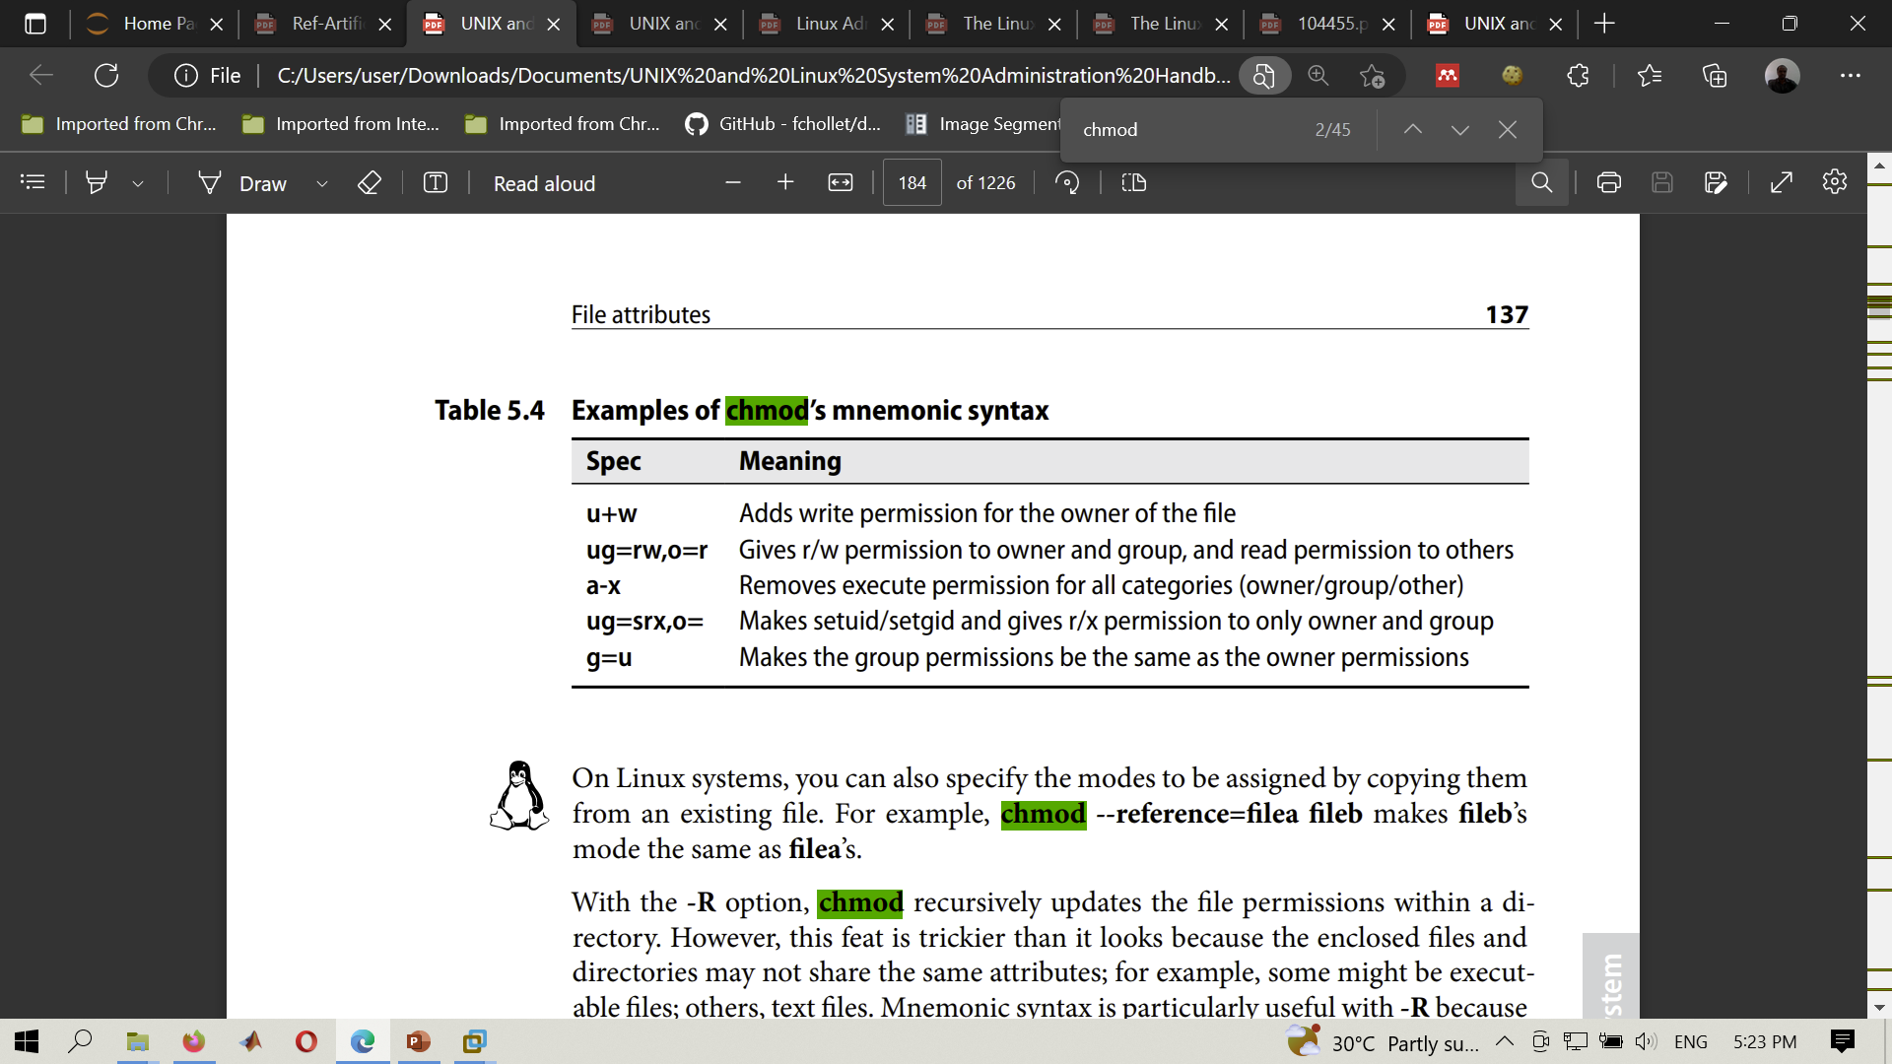
Security in Unix

Slide 15
Advanced File System Concepts
To change the mode of the file1.txt to executable>>chmod +x file1.txt
To execution permission for user >> chmod u+x file1.txt
To remove the execution permission for a group>> chmod g-x file1.txt
To remove the execution permission for a others>> chmod o-x file1.txt
To the group/user to read and write >>chmod g+rw file.txt
it should be noted that r=4 w=2 x=1 the user:Group:other
Therefore, user and others has permission of has read write and execute while group has none >> chmode 707 file1.txt

Slide 16
Cont.
To get the file without heading but having the permission list>> getfacl --omit-header filename

Slide 17

Disk management

Slide 18
Disk management
Identify the disks:
Use the fdisk or lsblk command to identify the disks attached to the system.
Partitioning:
Use the fdisk or gdisk command to partition the disks.
Partitioning creates logical subdivisions on a hard disk, which can be formatted with a file system and used to store data.
Creating file systems:
Once you have partitioned the disks, use the mkfs command to create file systems on the partitions.
Common file systems used in Linux are ext4, XFS, and Btrfs.
Mounting file systems:
Mounting a file system makes it accessible to the system.
Use the mount command to mount the file systems on directories in the file system hierarchy.

Slide 19
Cont.
Checking disk usage:
The df command displays the disk usage of file systems.
This can be useful for determining which file systems are full or nearly full.
Checking disk health:
Use the smartctl command to check the health of the disks attached to the system.
This can help to identify failing disks before data is lost.
Expanding file systems:
If you need to expand a file system, use the resize2fs command (for ext2, ext3, or ext4) or the xfs_growfs command (for XFS) to expand the file system to fill the available space.

Slide 20
Cont.
Unmounting file systems:
Before you can modify a file system, you must unmount it using the umount command.
Resizing partitions:
If you need to resize a partition, use the fdisk or gdisk command to delete the existing partition and create a new partition with the desired size.
RAID:
Linux also supports RAID (Redundant Array of Independent Disks) for data redundancy and performance.
The mdadm command can be used to configure and manage RAID arrays.

Slide 21

Backups

Slide 22
Backup using terminal
Open the terminal:
Open a terminal window in Linux by pressing Ctrl+Alt+T on the keyboard.
Navigate to the desired directory:
Use the cd command to navigate to the directory where you want to create the backup.
Create a backup directory:
Use the mkdir command to create a directory to store the backup.
Run the backup command:
Use the tar command to create a compressed archive of the files you want to backup.
The syntax of the command is>> tar -czvf backup_filename.tar.gz /path/to/directory
Here, -c is used to create an archive, -z is used to compress the archive, -v is used to display the progress of the backup process, -f is used to specify the filename of the backup file, and /path/to/directory is the path of the directory you want to backup.
Example: >> tar -czvf backup.tar.gz /home/user/Documents

Slide 23
Cont.
Verify the backup:
Once the backup process is complete, you can verify the contents of the backup by using the tar command again to list the contents of the backup file.
Example:>> tar -tzvf backup_filename.tar.gz
Here, -t is used to list the contents of the archive.
Move the backup file to the backup directory:
Use the mv command to move the backup file to the backup directory you created earlier.
Example: >>mv backup_filename.tar.gz /path/to/backup_folder

Slide 24
Automate the backup process:
Automate the backup process:
You can use the cron utility in Linux to automate the backup process at regular intervals.
cron is a time-based job scheduler in Linux that can be used to automate tasks, including backups.
Using >>crontab –e
rsync is a popular command-line tool used for transferring and synchronizing files between two locations.
It can be used to automate backups by setting up a cron job that runs at a specified interval.
Using>> rsync -avz /source/directory/ /destination/directory/

Slide 25

System Startup and Shutdown

Slide 26
Bootstrapping>starting up a computer
Bootstrapping is the standard term for starting up a computer.
During bootstrapping, the kernel is loaded into memory and begins to execute.
A variety of initialization tasks are performed, and the system is then made available to users.

Slide 27
The general steps involved in booting Linux
Power on the computer:
When you press the power button on your computer, it sends an electrical signal to the hardware components, which start initializing.
This process is called the Power On Self Test (POST).
BIOS initialization:
The Basic Input/Output System (BIOS) is responsible for initializing and configuring the hardware components of your computer.
This includes the CPU, memory, storage devices, and other peripherals.
Boot loader:
Once the BIOS completes its initialization, it searches for the boot loader on the storage devices connected to the computer.
The boot loader is a small program that loads the Linux kernel into memory.
Linux kernel initialization:
The Linux kernel is the core component of the operating system.
Once it is loaded into memory, it begins initializing the hardware components, setting up memory management, and launching critical system services.

Slide 28
Cont.
Init process:
After the kernel initializes, it starts the init process.
This process is responsible for starting all the user-level services and daemons that make up the Linux operating system.
It also sets up the environment variables and system settings.
Login screen:
Once all the necessary services and daemons are running, the login screen appears, prompting the user to enter their username and password.
Desktop environment:
After the user logs in, the desktop environment is loaded.
The desktop environment is the graphical interface that allows users to interact with the operating system and its applications.
Applications:
Finally, the user can start using applications and programs on the Linux operating system.

Slide 29
Shutdown the system
Open a terminal or use the graphical user interface:
You can either open a terminal and run the shutdown command with sudo privileges or use the graphical user interface menu to initiate the shutdown process.
Initiate the shutdown process:
In the terminal, run the command “sudo shutdown now” or “sudo poweroff” to initiate the shutdown process.
In the graphical user interface, click on the "Power Off" button in the menu and select "Shutdown" or "Power Off".
Send SIGTERM signal:
The init process sends a SIGTERM signal to all running processes, telling them to stop what they're doing and prepare for the shutdown.
Wait for processes to terminate:
The operating system waits for all processes to terminate gracefully.
If any processes don't stop within a certain time frame, the system will send a SIGKILL signal to forcefully terminate them.

Slide 30
Cont.
Unmount file systems:
The operating system unmounts file systems to ensure that no data is lost during the shutdown process.
Send ACPI signal:
The operating system sends an Advanced Configuration and Power Interface (ACPI) signal to the hardware components, telling them to power off.
Power off:
Finally, the computer powers off, completing the shutdown process.

Slide 31
As a system admin … no user has permission of doing anything meaning 000000000 Write the new permission to every group
U+rw, o+w ==
Go+rx, u+rwx ==
Ug+wr, o+x ==
g+r,u+w,o+r ==

